Slide 1
TRAVEL AGENCY
Samantha Belliveau, Mendy Wu, Dorothy Shek

Slide 2
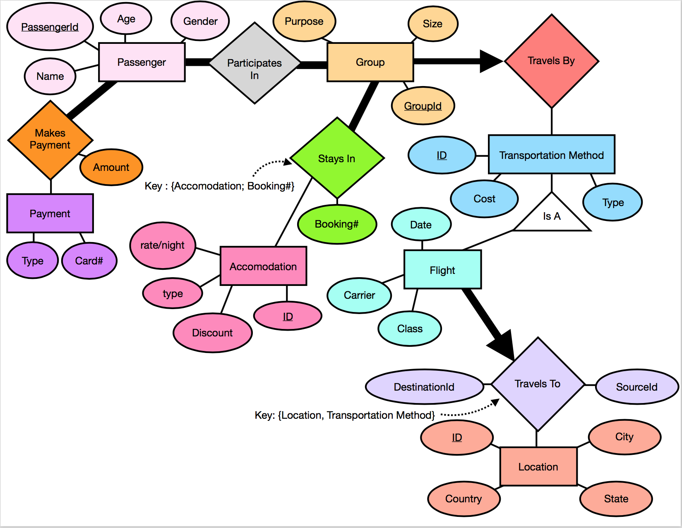
ER DIAGRAM

Slide 3
Tables in SQL
CREATE TABLE Passenger (
Id INT,
Age INT,
Gender CHAR(1) CHECK (Gender IN ('F', 'M', 'U')),
Name VARCHAR(40),
CHECK (Id >= 0),
CHECK (Age >= 0),
PRIMARY KEY (Id)
);
CREATE TABLE Grp (
Id INT,
Size INT,
Purpose VARCHAR(9) CHECK (Purpose IN ('Business', 'Pleasure', 'Education')),
CHECK (Id >= 0),
CHECK (Size >= 1),
PRIMARY KEY (Id)
);

Slide 4
Tables in SQL
CREATE TABLE ParticipatesIn (
PassengerId INT,
GrpId INT,
ReviewId INT,
PRIMARY KEY (PassengerId, GrpId),
FOREIGN KEY (GrpId) REFERENCES Grp(Id),
FOREIGN KEY (PassengerId) REFERENCES Passenger(Id),
);
CREATE TABLE Location (
Id INT,
City VARCHAR(30),
State VARCHAR(30),
Country VARCHAR(30),
CHECK (Id >= 0),
PRIMARY KEY (Id)
);

Slide 5
Tables in SQL
CREATE TABLE TransportationMethod (
Id INT,
Cost FLOAT(10, 2),
Type VARCHAR(6),
CHECK (Cost >= 0),
CHECK (Id >= 0),
CHECK (Type IN ('Flight', 'Car', 'Cruise')),
PRIMARY KEY (Id)
);
CREATE TABLE TravelsBy (
GrpId INT,
TransportationId INT,
PRIMARY KEY(GrpId),
FOREIGN KEY (GrpId) REFERENCES Grp(Id),
FOREIGN KEY (TransportationId) REFERENCES TransportationMethod(Id)
);

Slide 6
Tables in SQL
CREATE TABLE TravelsTo (
SourceId INT,
DestinationId INT,
TransportationId INT,
PRIMARY KEY (SourceId, DestinationId, TransportationId),
FOREIGN KEY (DestinationId) REFERENCES Location(Id),
FOREIGN KEY (SourceId) REFERENCES Location(Id),
FOREIGN KEY (TransportationId) REFERENCES TransportationMethod(Id)
);

Slide 7
Tables in SQL
CREATE TABLE Accommodation (
Id INT,
Name VARCHAR(30),
Rate FLOAT(10, 2),
Discount FLOAT(2, 2),
AccommodationType VARCHAR(30),
CHECK (Id >= 0),
CHECK (Rate >= 0),
PRIMARY KEY (Id)
);
CREATE TABLE Payment (
CardNumber INT,
Type VARCHAR(20),
PassengerId INT,
PRIMARY KEY (CardNumber),
FOREIGN KEY (PassengerId) REFERENCES Passenger(Id)
);

Slide 8
Tables in SQL
CREATE TABLE StaysIn (
AccommodationId INT,
BookingNumber INT,
GrpId INT,
CHECK (BookingNumber >= 0),
PRIMARY KEY (AccommodationId, BookingNumber),
FOREIGN KEY (AccommodationId) REFERENCES Accommodation(Id),
FOREIGN KEY (GrpId) REFERENCES Grp(Id)
);

Slide 9
Tables in SQL
CREATE TABLE MakesPayment (
PassengerId INT,
GrpId INT,
CardNumber INT,
Amount FLOAT(10, 2),
PRIMARY KEY(PassengerId, GrpId),
FOREIGN KEY (PassengerId) REFERENCES Passenger(Id),
FOREIGN KEY (GrpId) REFERENCES Grp(Id),
FOREIGN KEY (CardNumber) REFERENCES Payment(CardNumber)
);

Slide 10

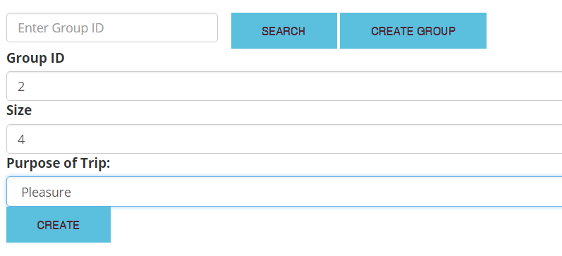
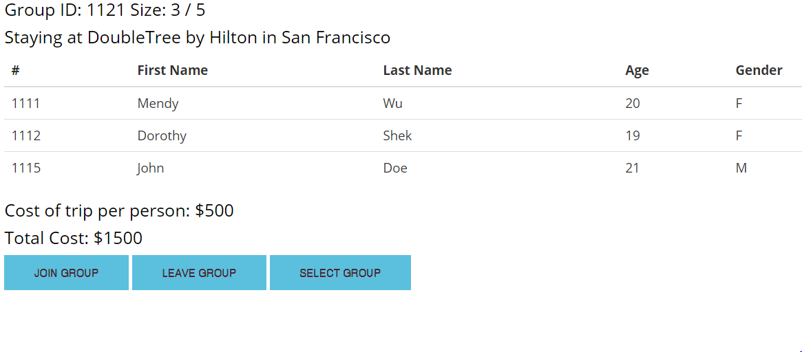
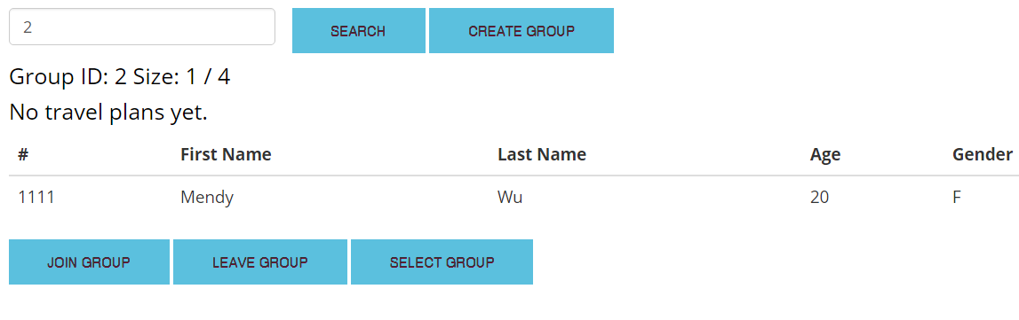
Search Group
Create Group
Group Transactions

Slide 11
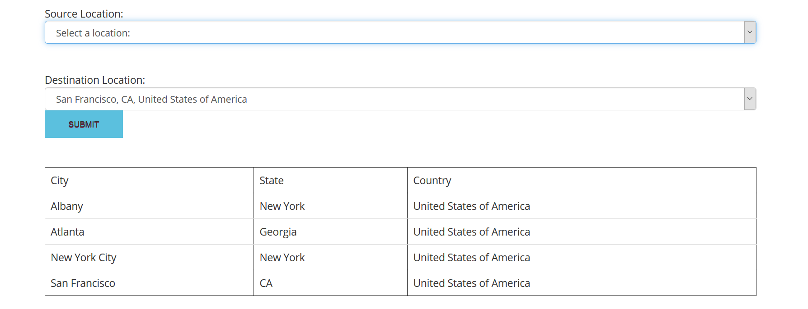
Location Transaction

Slide 12
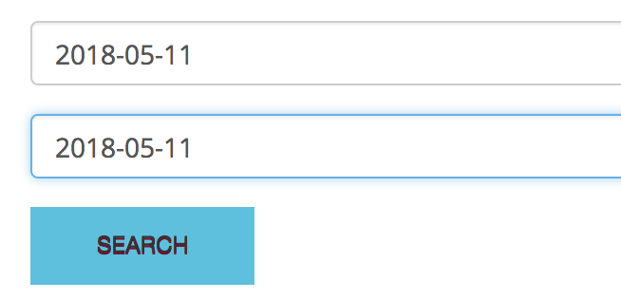
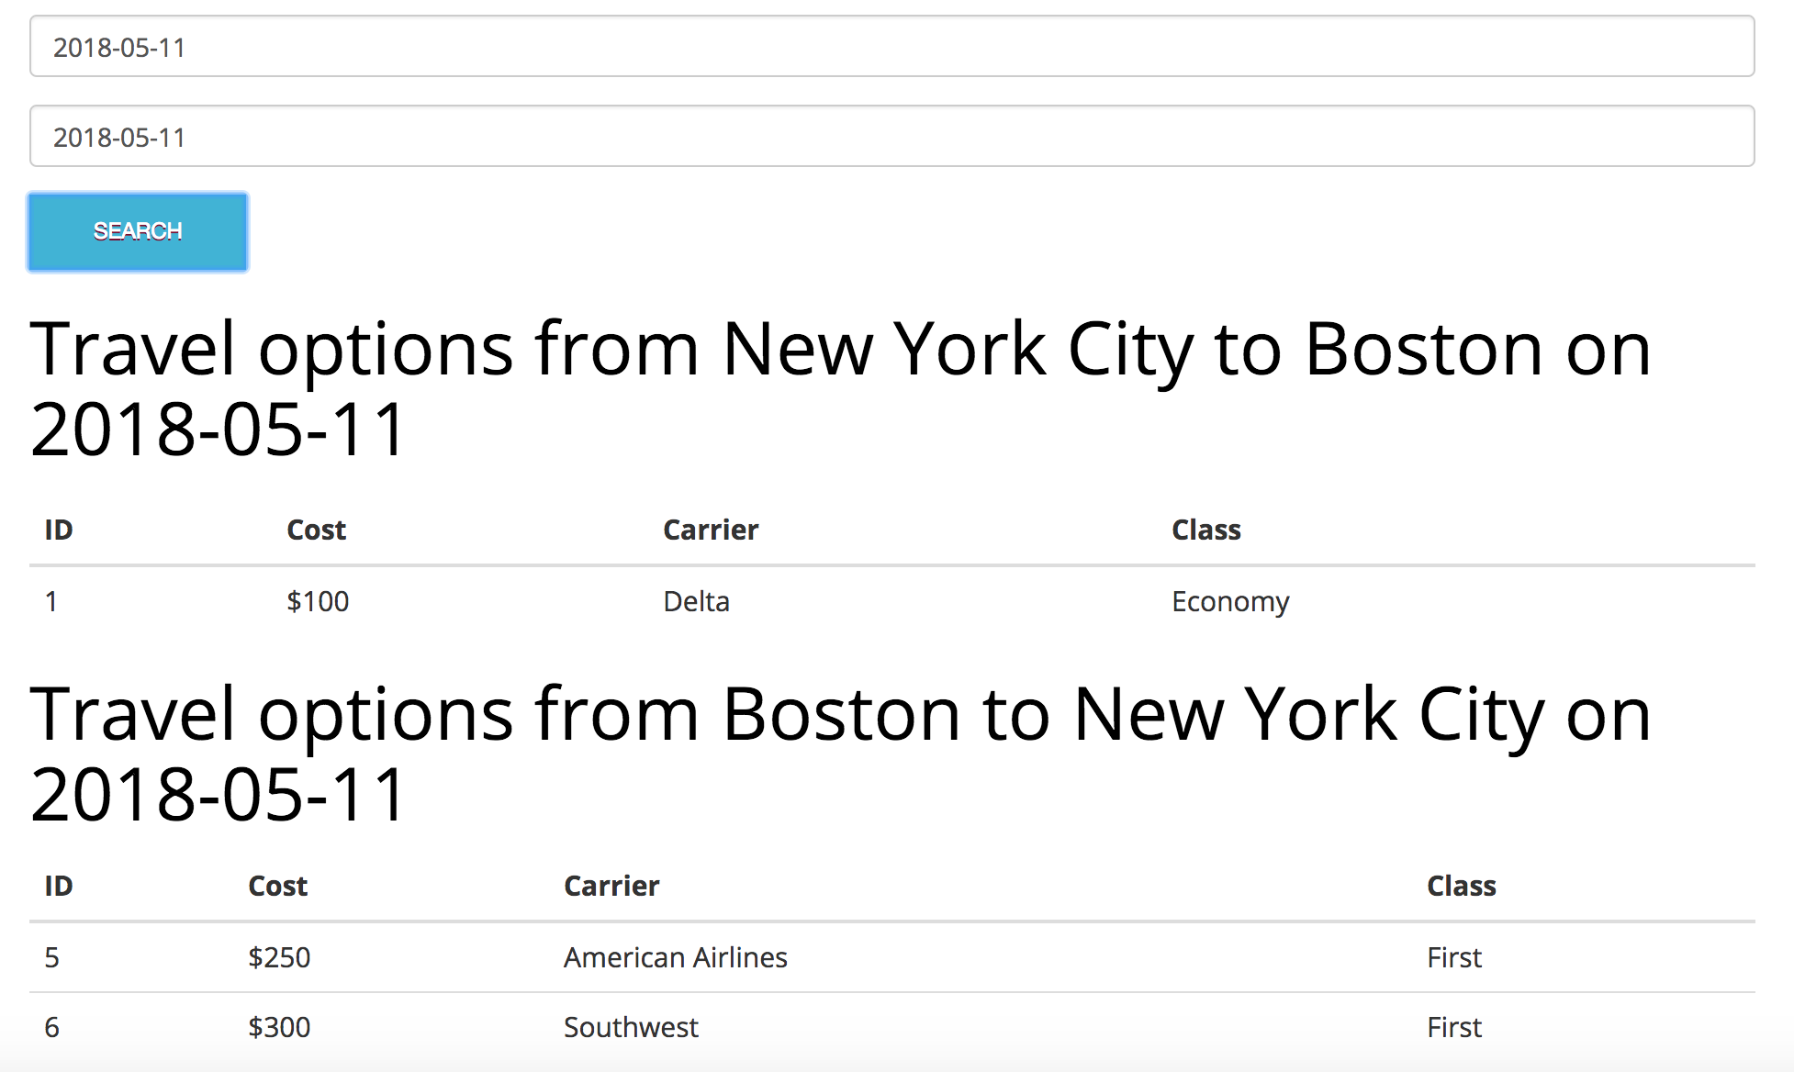
Search Transportation Transaction

Slide 13
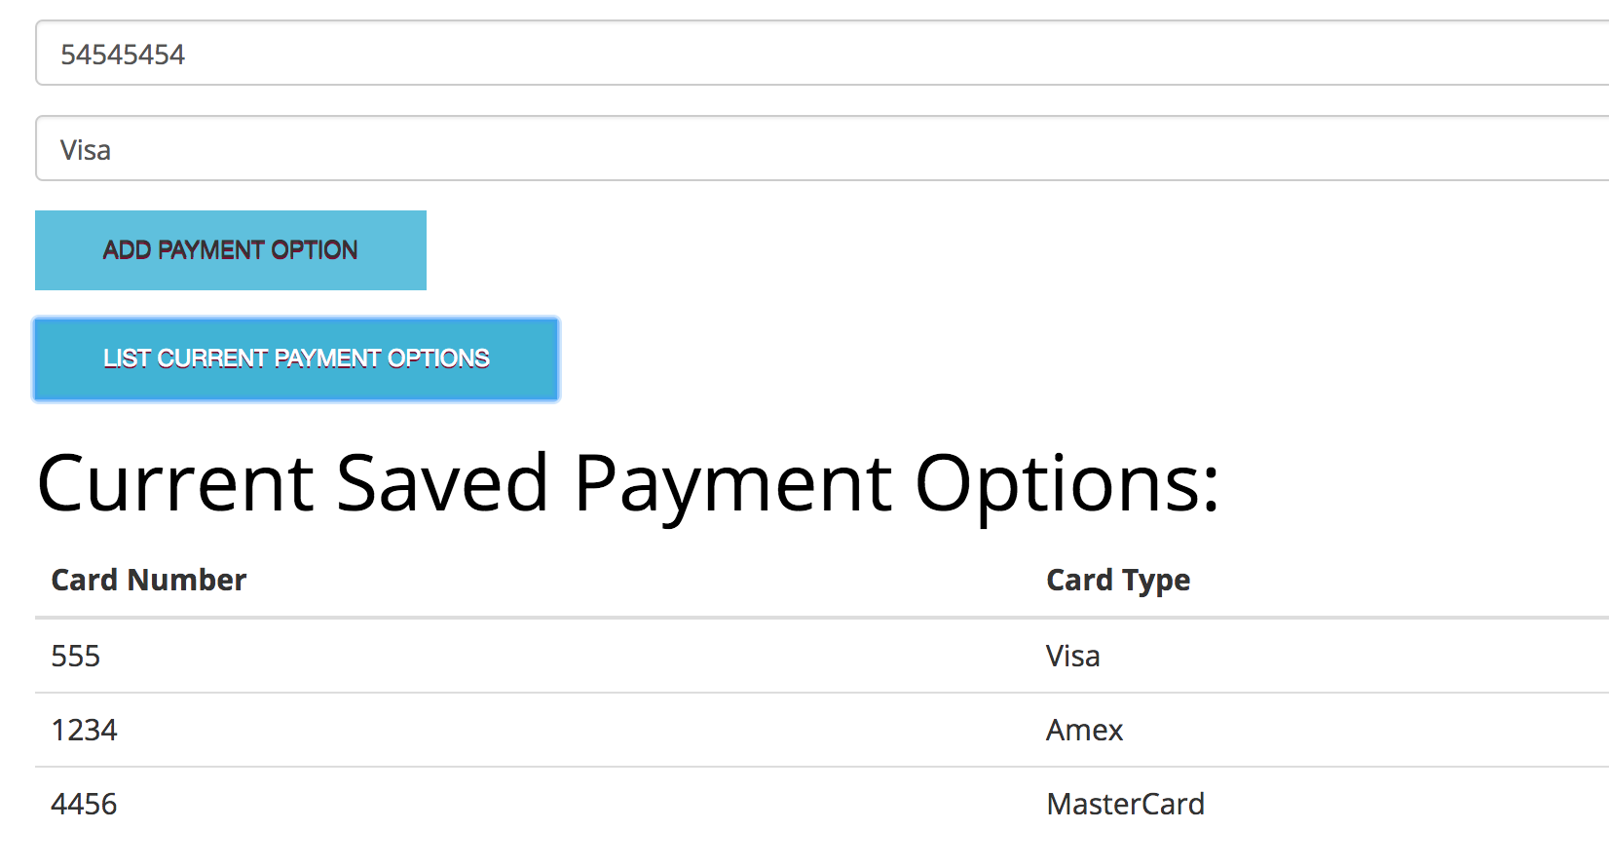
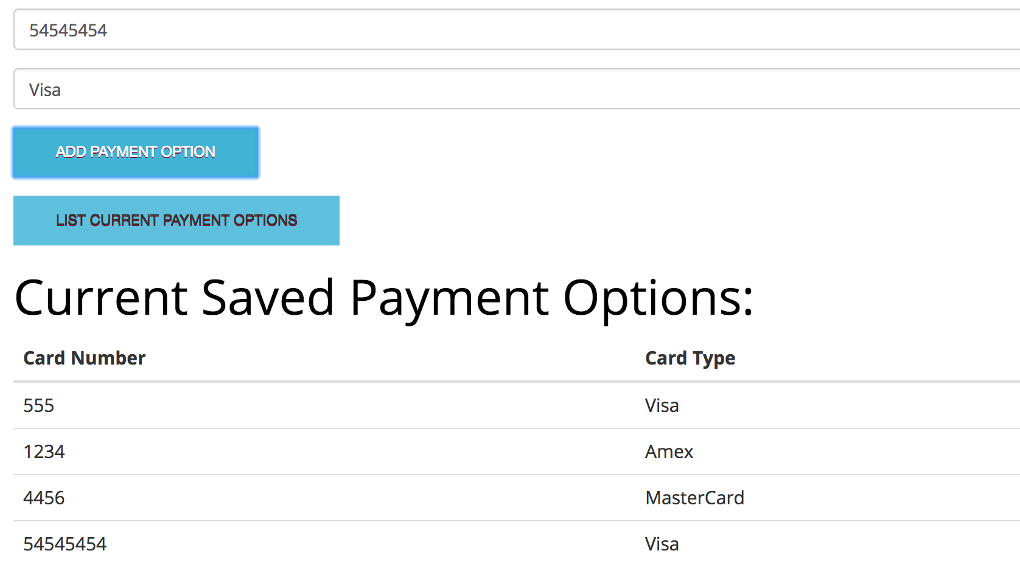
Add Payment Method Transaction

Slide 14
CONTRIBUTION SLIDE
Mendy: Travel Group and Accommodation pages
Sam: Sign In/Sign Up page, Transportation Page, Payment Page
Dorothy: Location page

